Slide 1
CCTV INVASION
GAMEPROG
SOPHI NURAENI – 2101705574 | JEVON WIRJONO – 2101705486 | LUKIUS JONATHAN – 2101705624 | PRAMADITO RAFIAQIL - 2101705542

Slide 2

ALERT
GAME CONCEPT
CCTV Invasion is an adventure fantasy 3D game which the character is a person who want to survive from this nightmare place and bring peaceful to him because he tired of running. He must survive from all the obstacle that hold his/her way to safe place.
GENRE GAME
Adventure, Fantasy, Survival, FPS
TARGET AUDIENCE
teenager until adult (over the age of 13 years)
people who attracted to action-fps genre game.

Slide 3
In this game player need to go through the map to complete the game. Character will have nothing in first respawn, and need to find gun, gate, open new map, etc. In this game player will survive alone and no one can help him, except the character itself.
This game design and gameplay were designed from a game called WatchDogs (from the CCTV) but different in game, in WatchDogs game we can see anything from CCTV sights and have big impact in that game, also in this game we want have the same objectives that CCTV have big impact. In this game CCTV want kill the character
GAME FLOW
LOOK AND FEEL

Slide 4

STORY SETTING
LEVEL
The goal in this game is the player needs to reach the safehouse,
and on the way to find a safehouse player will be attacked by CCTV, player can choose to engage enemies or going stealthly. the character in this game has been built to recover the supply
Level can be choosed from easy , normal ,hard. This level affects the attack speed and CCTV detection distance
LEVEL
Game World
Story took place in Machine post-Apocalyptic city
The place will look desolate and messy
The Sky will be gloomy due to mass industry
Character
The Character is a scavenger of the outside world. He often put supply that he steal and place it in his safe house.

Slide 5
INTERFACE
INTERFACE
SOUND EFFECT
The sound effect in this game is used when players are take an action like
when taking an item there is a sound effect of the item being taken
when shooting use pistol/shotgun there is a shot sound effect
when destroying the object there will be a sound effect of the broken object
when walking there are foot stepping sound effect
when jumping there is a sound effect landing on the ground
when there is little life left there will be a sound effect of rapid heartbeat
VISUAL SYSTEM
( Camera View ) first person perspective that makes the player invisible because he is behind the weapon.
( HUD ) HP, Switch Weapon, bullets available, control system information, menu (can show/hide)
MUSIC
This game has a deserted city theme that has been abandoned and uninhabited. so the background music used in this game is a calm sound that shows an uninhabited city that is the sound of nature such as the sound of the wind, the sound of tree leaves rubbing against, the sound of water

Slide 6
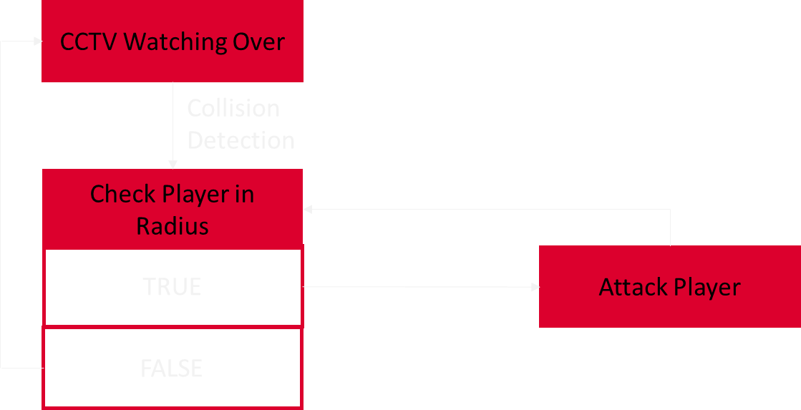
ALER
COLLI
ENEMY AI
COLLISION DETECTION
PLAYER AND ENEMY
Using Circle Collision as collision detection (transparent circle in a player and enemy), it will check the distance between the two center points of the circle. If yes, then there is no collision and if it is not, then a collision has occurred means the player is in the cctv radius so cctv will attack the player
WALL AND ITEM
Using Bounding Box as collision detection which is a transparent box. Ensure there is no distance between the two boxes, so that when the two boxes touch for the wall player it will not be able to pass through the wall while for items for detector that items can be retrieved

Slide 7
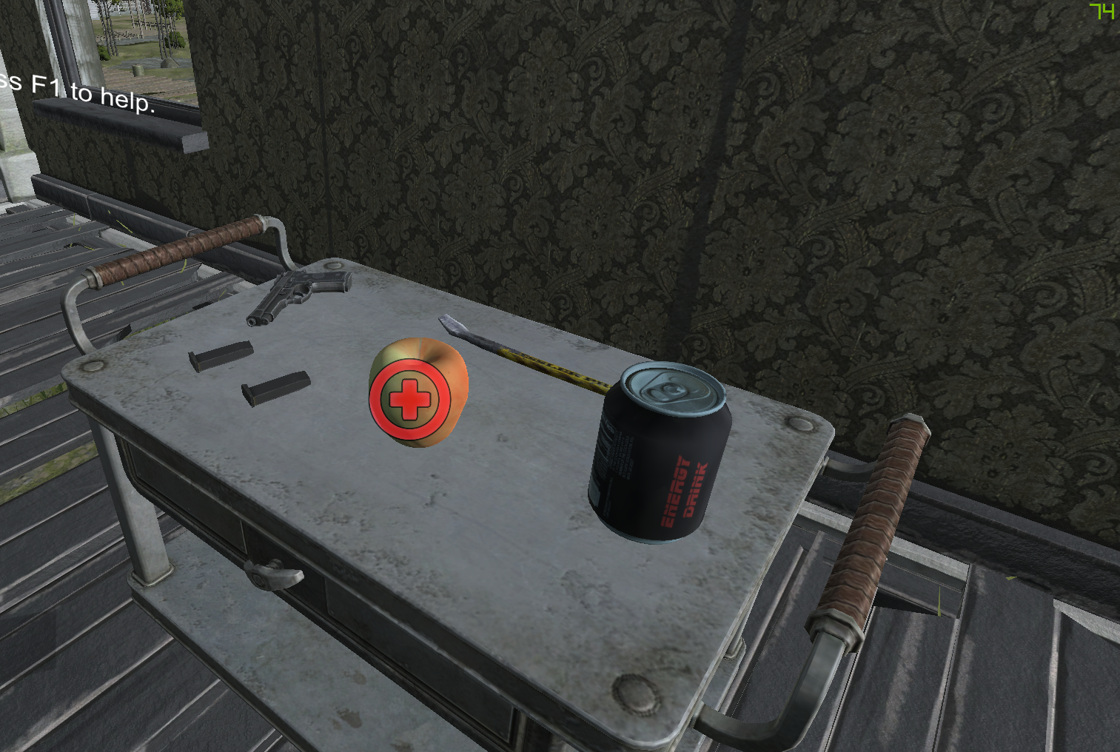
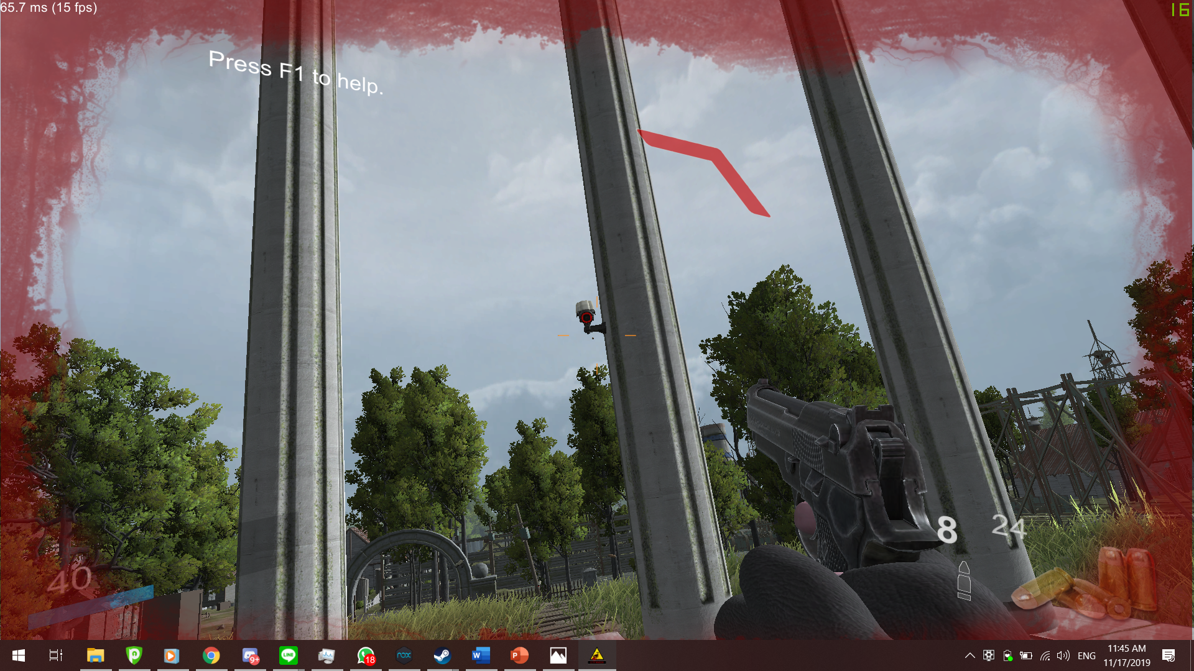
GAMEPLAY
MISSION & CHALLANGE
GAME PROGRESSION
The player will be encountering various enemies throughout the stage which is CCTV placed around the map. Encountered enemies will Shoot player in their line of sight
At the beginning of the game, the player is given the starter weapon and starting consumable

Slide 8
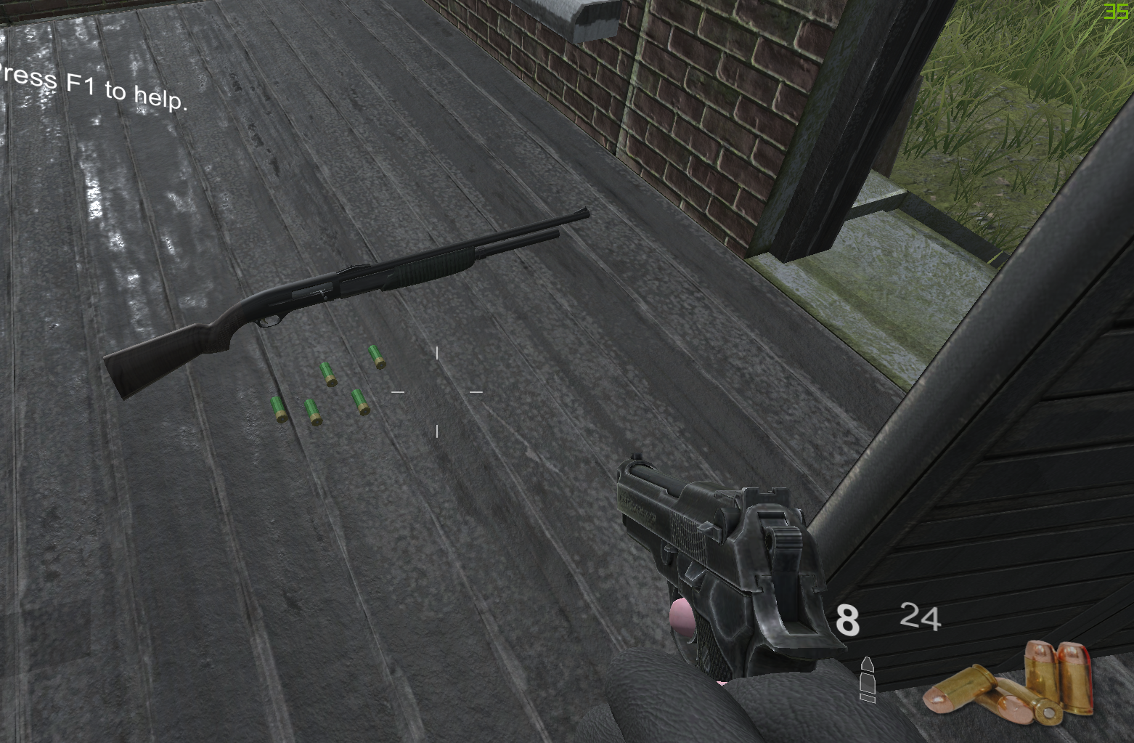
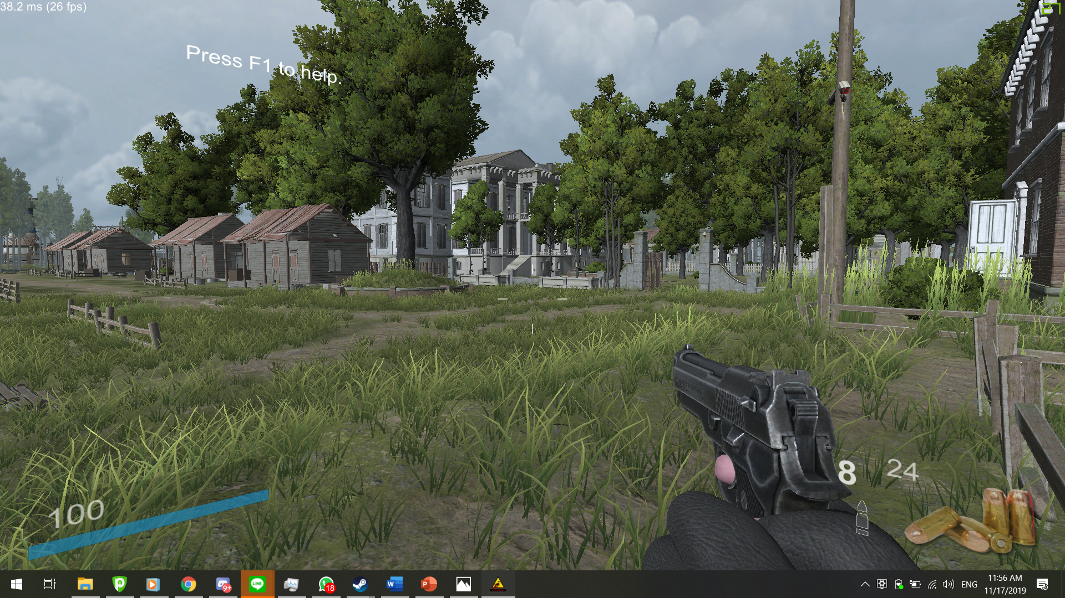
PUZZLE STRUCTURE
OBJECTIVES
In this section, the player will have to find other weapon hidden throughout the map. Upon finding the weapon, the player will be rewarded with new powerful tools.
When the player is in the stage, the player must find their way to the end area through combat and exploration

Slide 9
MECH
HANI
MECHANICS
IN THE GAME
PHYSICS
Gravity exists, and will affect player’s drop speed, while player also get damaged from falling from high altitude.
MOVEMENT GAME
Player is able to move through the 3d space like a normal person, which can walk, run and jump. Player can also sprint to move faster for avoid damage from various hazards.
OBJECTS
Players automatically pick up objects such as weapons and abilities on touching said object. Furthermore, the player can organize the weapons and abilities through the inventory menu.
ACTION
Players can pick up objects such as weapons on hovering said object. Furthermore, the player can organize the weapons through the inventory menu.
COMBAT
The player is given a fast moves to be used in combat against hostile NPCs
ECONOMY
In this game, ammo is obtained from anywhere. The player can gain more ammo that they can find through out the map.

Slide 10
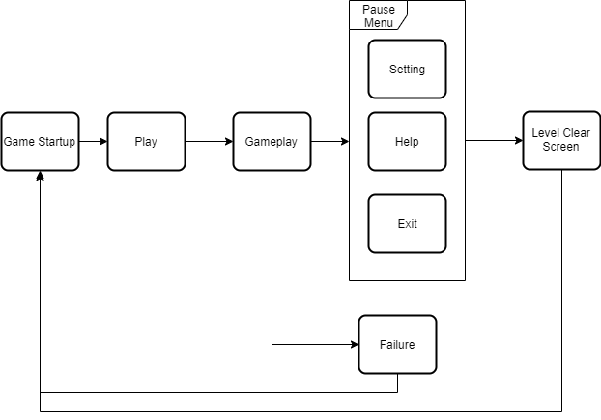
Replaying and Saving
SCREEN FLOW
Saving in-game is automatically done to prevent save scumming. If the player exits and re-enters the game, then the player will be transported to the last checkpoint.

Slide 11

DEVELOPMENT
HARDWARE
Development Software
Adobe Illustrator CC 2019
Adobe Photoshop CC 2019
Unreal Engine 4 or Unity
Development Hardware Specification
Game Engine: Unity 2018.3.0f2
OS: Windows 10
Processor: Intel - Core i7-7700HQ CPU @ 2.8 GHz (8 CPUS), ~2.8GHz
Graphics : GeForce GTX 1050 Graphics Cards
Storage: SSD 128 GB and HDD 1 TB
RECOMENDATION SOFTWARE & HARDWRE

Slide 12
THANK
YOU
ANY
QUESTION ?

